Slide 1

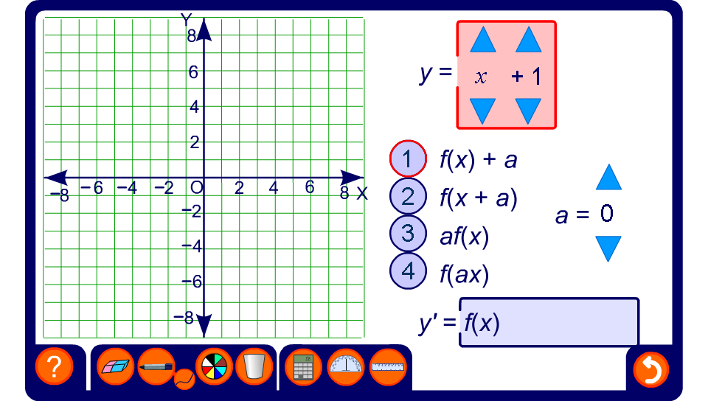


Transforming linear functions
Notes:
Use this activity to investigate a variety of transformations applied to linear functions.
Once a transformation has been chosen the equation for the original graph can be modified to explore the effect of the chosen transformation.
To explore the transformations given by –f(x) and f(–x) choose af(x) or f(ax) and set the value of a to –1.
Translations of trigonometric functions are examined in S4 Further trigonometry.

